Slide 1

Web Development & Design Foundations with HTML5
Tenth Edition
Chapter 6
Page Layout Basics
Copyright © 2021, 2019, 2017 Pearson Education, Inc. All Rights Reserved

Slide 2
Learning Outcomes (1 of 2)
In this chapter, you will learn how to ...
Describe and apply the CSS Box Model
Configure width and height with CSS
Configure margin with CSS
Configure float with CSS
Configure fixed, relative, absolute, and sticky positioning with CSS
Create two-column page layouts using CSS
Configure navigation in unordered lists and style with CSS

Slide 3
Learning Outcomes (2 of 2)
Add interactivity to hyperlinks with CSS pseudo-classes
Configure a hyperlink to a named fragment internal to a web page
Configure images with CSS sprites
Configure CSS for printing
Configure a single page website with parallax scrolling

Slide 4
Width and Height with CSS
Table 6.1 Unit Types and Purpose
Unit | Purpose
px | Configures a fixed number of pixels as the value
em | Configures a value relative to the font size
% | Configures a percentage value of the parent element
vh | Configures a value relative to 1% of the viewport height
vw | Configures a value relative to 1% of the viewport width

Slide 5
CSS Width and Height Properties
width property
Configures the width of an element’s content
min-width property
Configures minimum width of an element
max-width property
Configures the maximum width of an element
height property
Configures the height of an element
h1{ width: 80%; }
h1{ height: 100px; }

Slide 6
The Box Model
Content
Text & web page elements in the container
Padding
Area between the content and the border
Border
Between the padding and the margin
Margin
Determines the empty space between the element and adjacent elements

Slide 7
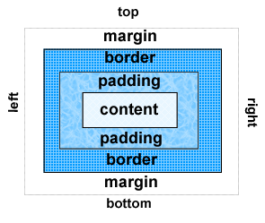
Figure 6.6 The CSS box model

Slide 8
Configure Margin with CSS
The margin property
Related properties:
margin-top, margin-right, margin-left, margin-bottom
Configures empty space between the element and adjacent elements
Syntax examples
h1 { margin: 0; }
h1 { margin: 20px 10px; }
h1 { margin: 10px 30px 20px; }
h1 { margin: 20px 30px 0 30px; }

Slide 9
Configure Padding with CSS
The padding property
Related properties:
padding-top, padding-right, padding-left, padding-bottom
Configures empty space between the content of the HTML element (such as text) and the border
Syntax examples
h1 { padding: 0; }
h1 {padding : 20px 10px; }
h1 {padding : 10px 30px 20px; }
h1 {padding : 20px 30px 0 30px; }

Slide 10
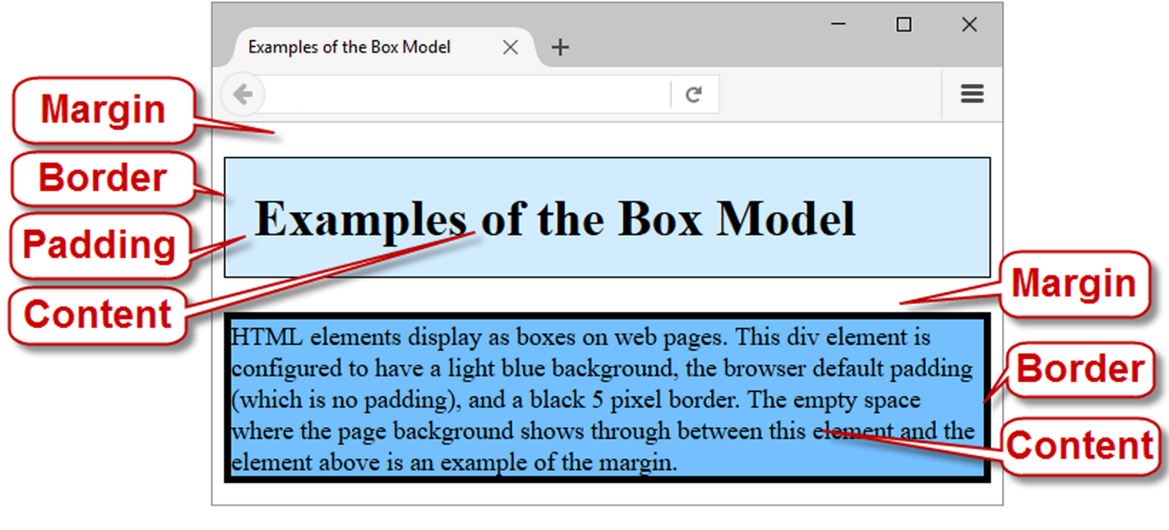
Box Model in Action
Figure 6.7 Examples of the box model

Slide 11
The CSS box-sizing Property
Default value for width or height is the value for ONLY the content (not including border and padding).
The box-sizing property with border-box value directs the browser to calculate the width and height of an element to include the value for content, padding, and border.
Use the universal selector (*) to apply this to all the element on the page
Example:
* { box-sizing: border-box; }

Slide 12
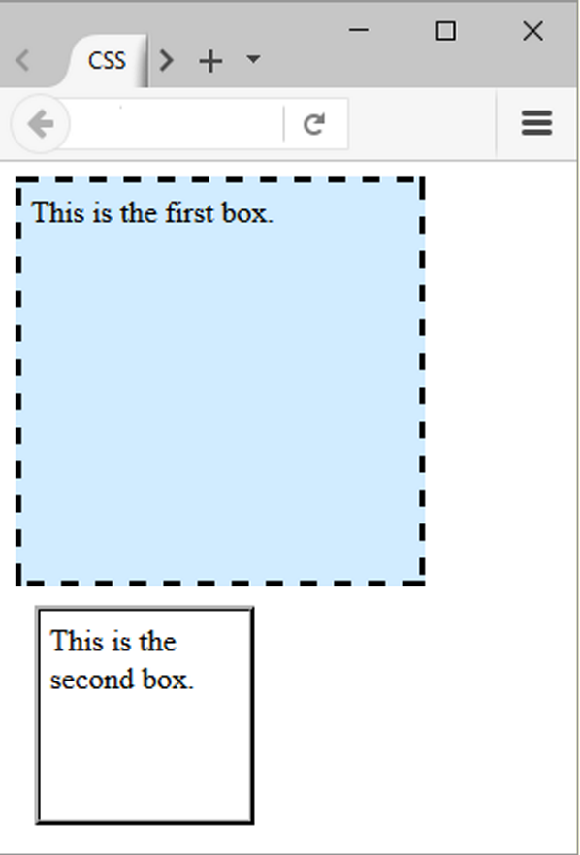
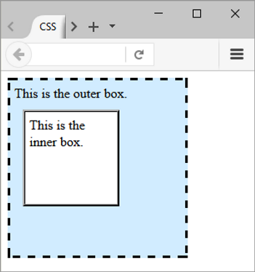
Normal Flow
Browser display of elements in the order they are coded in the web page document
Figure 6.9 Nested divelements
Figure 6.8 Two divelements

Slide 13
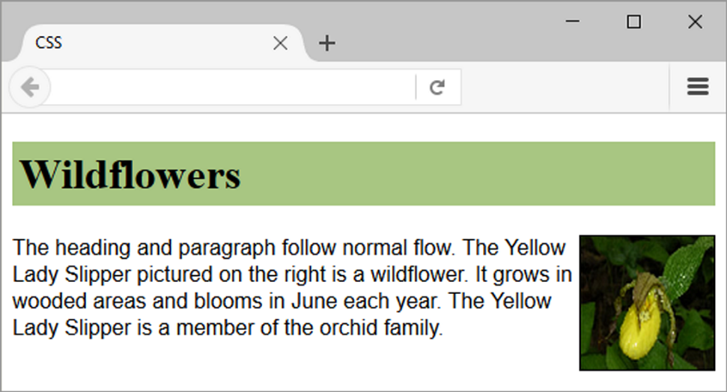
Figure 6.10 The image is configured to float

Slide 14
float Property (1 of 2)
h1 { background-color: #CCCCCC;
padding: 5px;
color: #000000;
}
p { font-family: Arial,sans-serif;
}
#yls { float: right;
margin: 0 0 5px 5px;
border: 1px solid #000000;
}

Slide 15
float Property (2 of 2)
Elements that seem to “float" on the right or left side of either the browser window or another element are often configured using the float property.

Slide 16
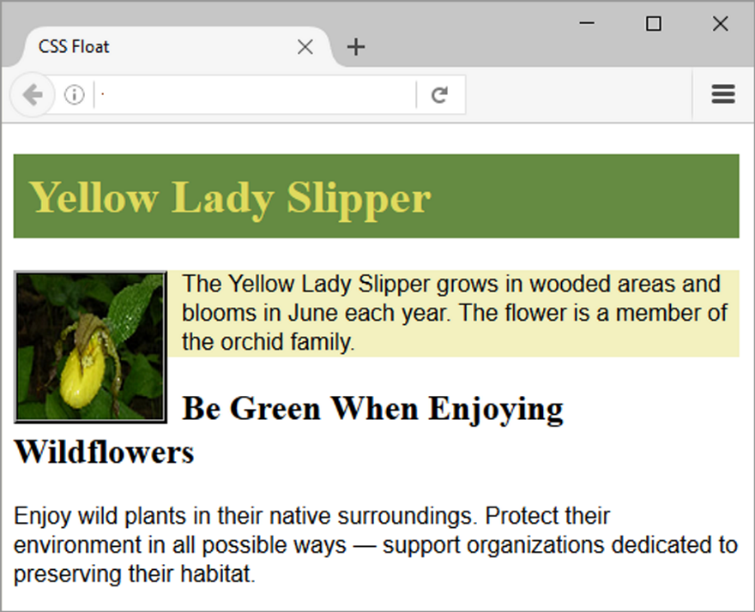
Figure 6.11 The CSS float property left aligns the image
The h2 text is displayed in normal flow.

Slide 17
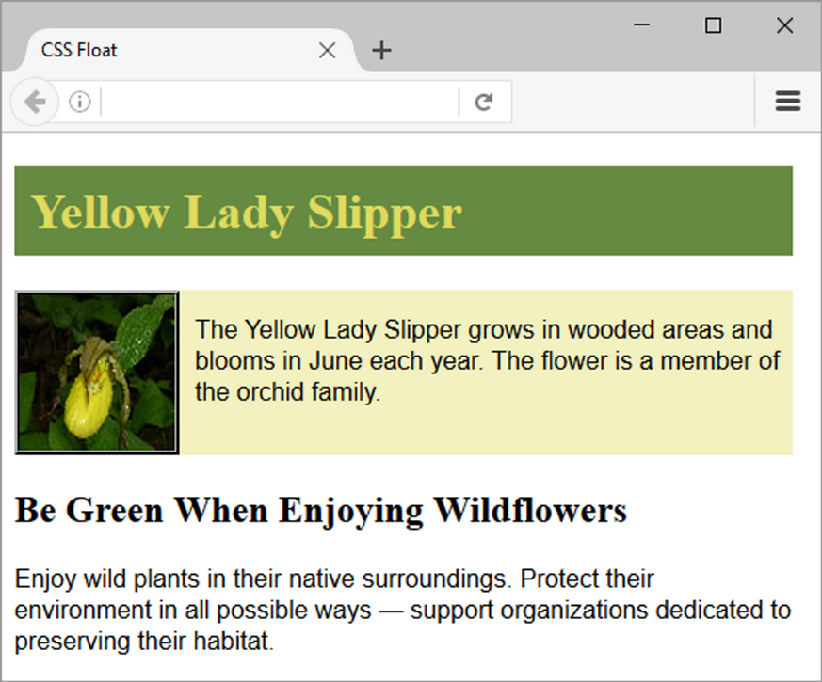
clear Property
Useful to “clear” or terminate a float
Values are left, right, and both
Apply clear: left; to a line break element within the div element. Now, the h2 begins on a new line under the floated image.
Figure 6.12 The clear property is applied to a line break tag

Slide 18
overflow Property
Intended to configure the display of elements on a web page.
However, it is useful to “clear” or terminate a float before the end of a container element
Values are auto, hidden, and scroll

Slide 19

Figure 6.14 The overflow property is applied to the div selector
overflow: auto; was applied to the div that contains the image and paragraph. Now the background extends and the h2 text displays AFTER the floated image.

Slide 20
Checkpoint (1 of 2)
List the components of the box model from innermost to outermost.
Describe the purpose of the CSS float property.
Which two CSS properties can be used to clear a float?

Slide 21
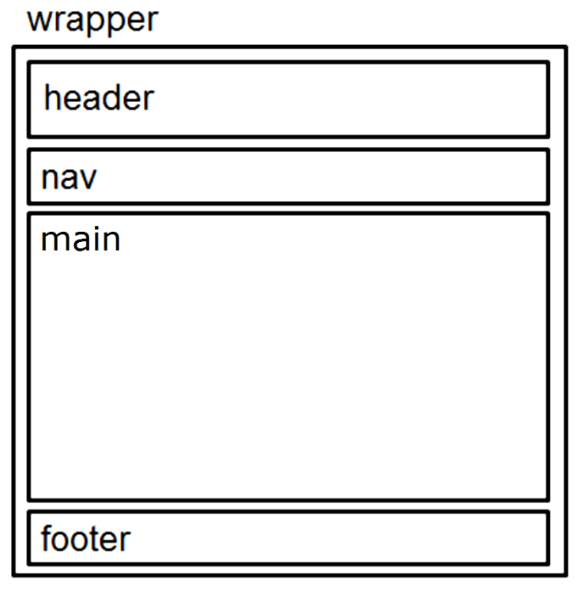
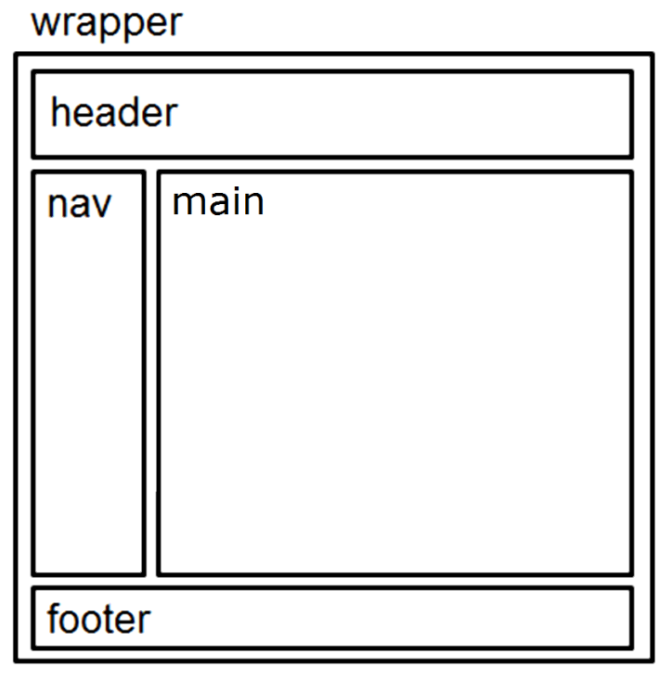
Page Layout Single Column -> Two Column
Single Column Wireframe
Two Column Wireframe
Figure 6.18 Single-column layout.
Figure 6.19 Two-column layout.

Slide 22
Basic Two-Column Layout (1 of 3)
<body>
<div id="wrapper">
<header> <header>
<nav> </nav>
<main> </main>
<footer> </footer>
</div>
</body>
Figure 6.19 Two-column layout.

Slide 23
Basic Two-Column Layout (2 of 3)
#wrapper { width: 80%;
margin-left: auto;
margin-right: auto;
background-color: #EAEAEA; }
header { background-color: #CCCCFF; }
h1 { margin: 0; padding: 10px; }
nav { float: left;
width: 90px;
padding: 10px; }

Slide 24
Basic Two-Column Layout (3 of 3)
main { margin-left: 100px;
padding: 10px;
background-color: #FFFFFF; }
footer { text-align: center;
font-style: italic;
background-color: #CCCCFF; }

Slide 25
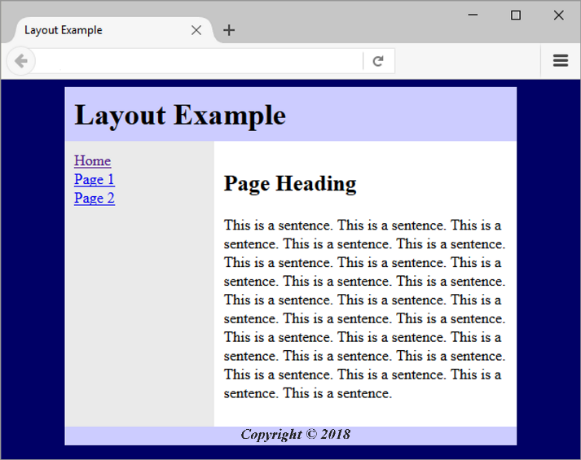
Figure 6.23 Final two-column layout

Slide 26
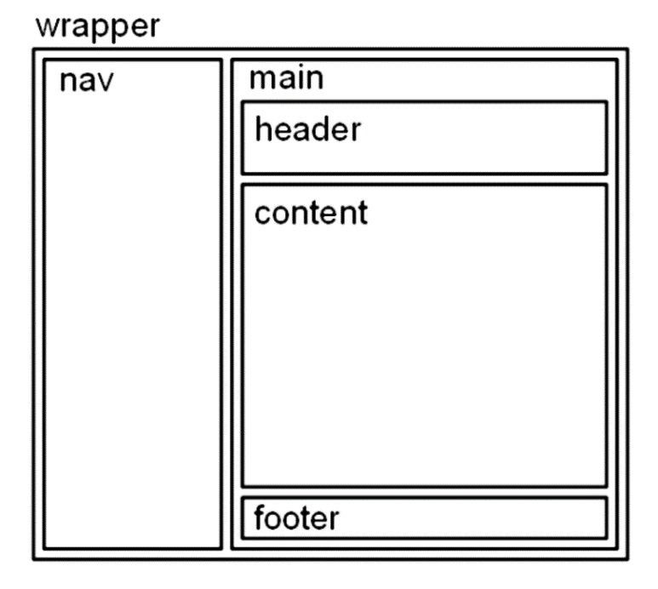
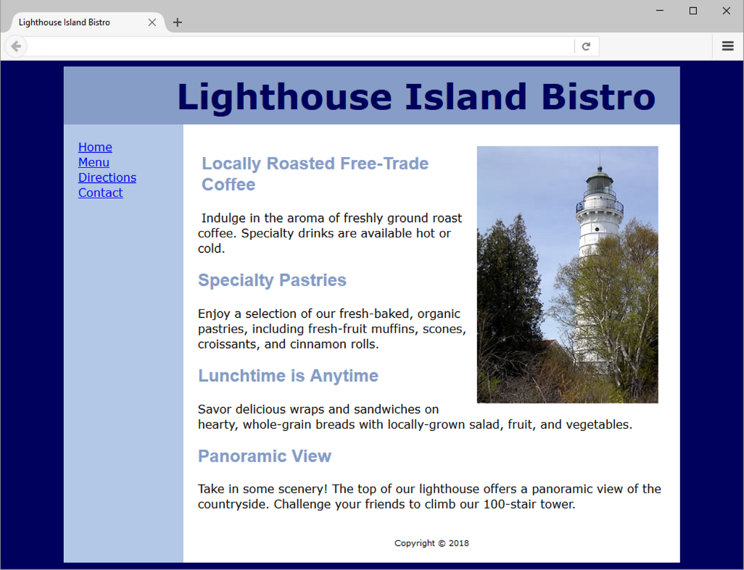
CSS Page Layout Two Columns (left nav)
Figure 6.24 Alternate wireframe
Figure 6.25 Page with alternate layout

Slide 27
CSS display Property (1 of 2)
Configures how and if an element is displayed
display: none;
The element will not be displayed.
display: block;
The element renders as a block element – even if it is actually an inline element, such as a hyperlink.
display: inline;
The element renders as an inline element – even if it is actually a block element – such as a <li>.

Slide 28
CSS display Property (2 of 2)
display: inline-block;
The element will display as an inline display element adjacent to other inline display elements but also can be configured with properties of block display elements including width and height.
display: flex;
The element displays as a block-level flex container (Chapter 7)
display: grid;
The element displays as a block-level grid container (Chapter 7)

Slide 29
Vertical navigation (1 of 2)
<nav>
<ul>
<li><a href="index.html">Home</a></li>
<li><a href="menu.html">Menu</a></li>
<li><a href="directions.html">Directions</a></li>
<li><a href="contact.html">Contact</a></li>
</ul>
</nav>

Slide 30
Vertical navigation (2 of 2)
CSS removes the list marker and underline:
nav ul { list-style-type: none; }
nav a { text-decoration: none; }
Figure 6.29 Navigation in an
unordered list
Figure 6.31 The CSS text-decoration
property has been applied

Slide 31
Horizontal Navigation (1 of 2)
HTML:
<nav>
<ul>
<li><a href="index.html">Home</a></li>
<li><a href="menu.html">Menu</a></li>
<li><a href="directions.html">Directions</a></li>
<li><a href="contact.html">Contact</a></li>
</ul>
</nav>
Figure 6.32 Navigation in an unordered lisxt

Slide 32
Horizontal Navigation (2 of 2)
CSS removes the list marker, removes the underline, adds padding, and configures the list items for inline display.
nav ul { list-style-type: none;}
nav a { text-decoration: none;
padding-right: 10px; }
nav li { display: inline; }

Slide 33
CSS Pseudo-classes (1 of 2)
Pseudo-classes and the anchor element
link – default state for a hyperlink
visited – a hyperlink that has been visited
focus – triggered when the hyperlink has focus
hover – triggered when the mouse moves over the hyperlink
active – triggered when the hyperlink is being clicked
a:link {color:#000066;}
a:visited {color:#003366;}
a:focus {color:#FF0000;}
a:hover {color:#0099CC;}
a:active {color:#FF0000;}

Slide 34
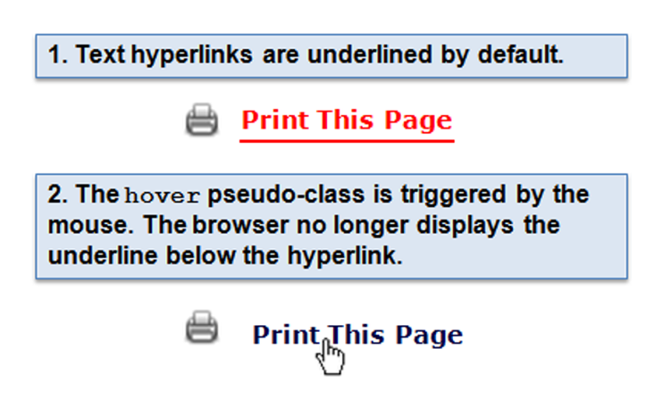
CSS Pseudo-classes (2 of 2)
a:link { color: #ff0000; }
a:hover { text-decoration: none;
color: #000066; }
Figure 6.33 Using the hover pseudo-class

Slide 35
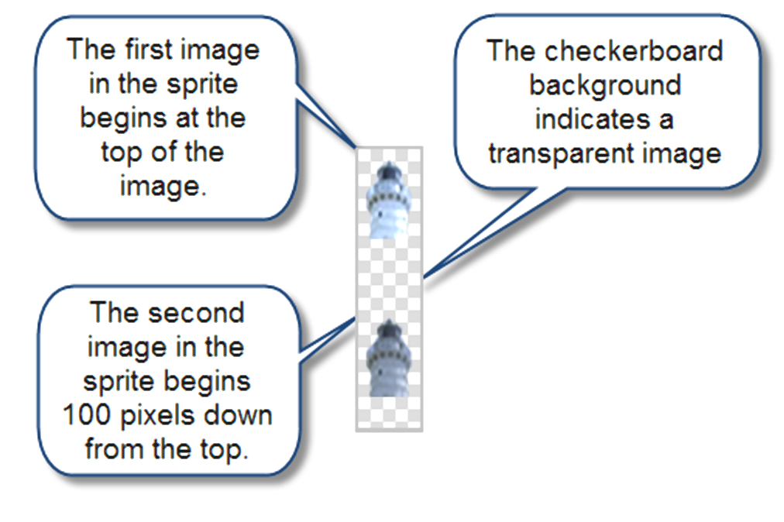
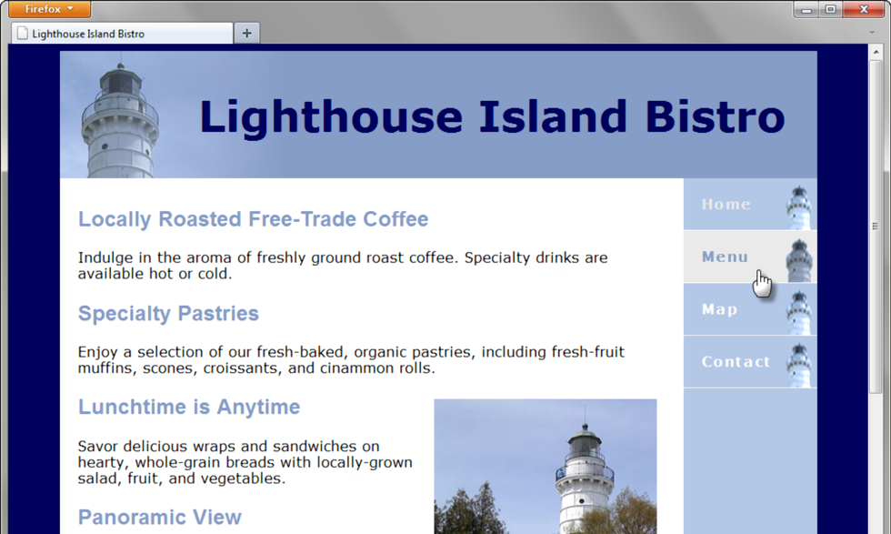
CSS Sprites
Sprite
an image file that contains multiple small graphics
advantage: saves download time
Figure 6.40 The sprite consists of two
images in a single graphics file
Figure 6.41 Sprites in action

Slide 36
CSS Styling for Print
Create an external style sheet with the configurations for browser display.
Create a second external style sheet with the configurations for printing.
Connect both of the external style sheets to the web page using two <link > elements.
<link rel="stylesheet" href="wildflower.css" type="text/css" media="screen">
<link rel="stylesheet" href="wildflowerprint.css" type="text/css" media="print">

Slide 37
Print Styling Best Practices
Hide non-essential content Example:
#nav { display: none; }
Configure font size and color for printing
Use pt font sizes, use dark text color
Control page breaks
Example:
.newpage { page-break-before: always; }

Slide 38
Position Property
Table 6.8 The position Property
Value | Purpose
static | Default value; the element is rendered in normal flow
fixed | Configures the location of an element within the browser viewport; the element does not move when the page is scrolled (Element is removed from normal flow)
relative | Configures the location of an element relative to where it would otherwise render in normal flow
absolute | Precisely configures the location of an element outside of normal flow
sticky | Combines features of relative and fixed positioning

Slide 39
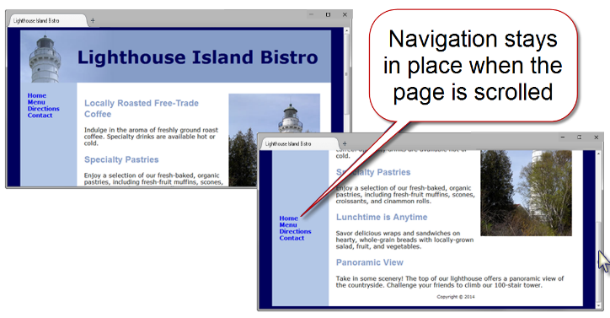
Fixed Positioning
nav { position: fixed; }
Figure 6.43 The navigation is configured with fixed positioning

Slide 40
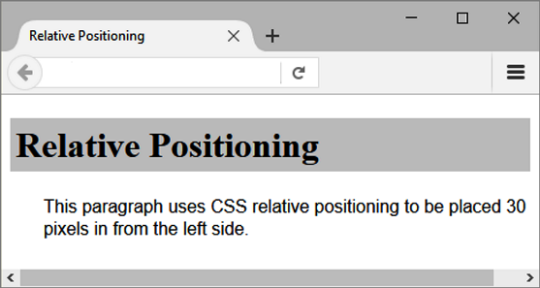
Relative Positioning (1 of 2)
Figure 6.44 The paragraph is configured using relative positioning

Slide 41
Relative Positioning (2 of 2)
p { position: relative;
left: 30px;
font-family: Arial, sans-serif; }
Changes the location of an element in relation to where it would otherwise appear in normal flow

Slide 42
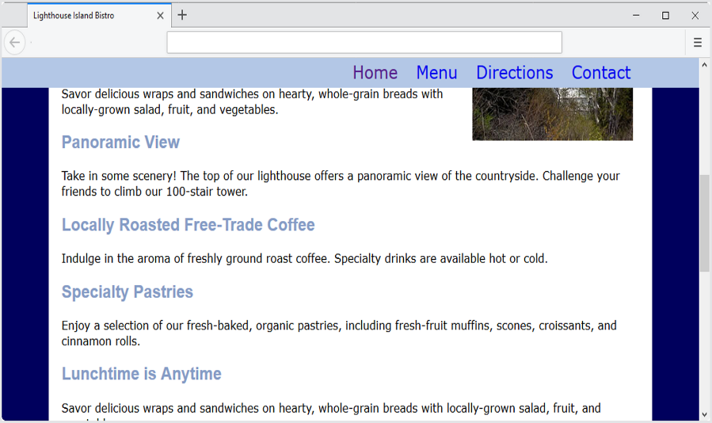
Sticky Positioning (1 of 2)
“Sticky” Navigation Bar
Figure 6.49 The navigation bar stays in place while the content is scrolled.

Slide 43
Sticky Positioning (2 of 2)
nav { position: sticky;
top: 0;
Combines features of relative and fixed positioning
Element rendered in normal flow and then, when reached during scrolling, sticks to the specified position and remains there

Slide 44
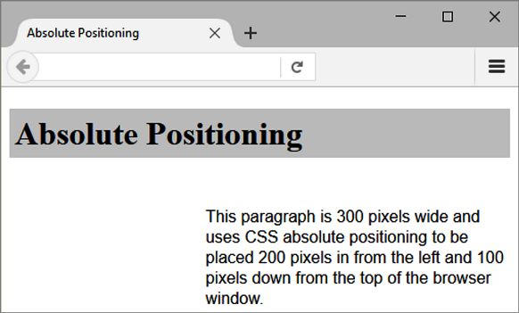
Absolute Positioning (1 of 2)
Figure 6.45 The paragraph is configured with absolute positioning

Slide 45
Absolute Positioning (2 of 2)
p { position: absolute;
left: 200px;
top: 100px;
font-family: Arial, sans-serif;
width: 300px; }
Precisely specifies the location of an element outside of normal flow
in in relation to its first parent non-static element

Slide 46
Stacking Order with the z-index Property (1 of 2)
Configure a third dimension: the stacking order of positioned elements
Default z-index is 0
Elements with higher z-index values will stack on top of elements with lower z-index values

Slide 47
Stacking Order with the z-index Property (2 of 2)
Example: Fixed Position Navigation Bar
nav { position: fixed; top: 0; left: 0;
height: 40px;
width: 100%; min-width: 40em;
background-color: #B3C7E6; }

Slide 48
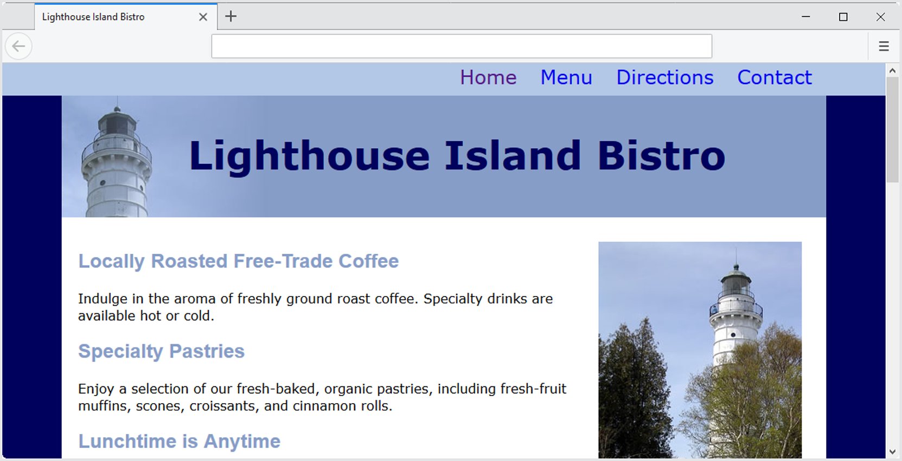
Figure 6.48 The web page has a fixed top navigation bar.

Slide 49

Figure 6.49 The navigation bar stays in place while the content is scrolled.

Slide 50
HTML Linking to Fragment Identifiers
A hyperlink to a part of a web page
Also called named fragments, fragment ids
Two components:
The element that identifies the named fragment of a web page. This requires the id attribute.
<div id=“top”> ….. </div>
The anchor tag that links to the named fragment of a web page. This uses the href attribute. <a href=“#top”>Back to Top</a>
Note the use of the # in the anchor tag!

Slide 51
Single Page Website (1 of 3)
Figure 6.51 Single page website

Slide 52
Single Page Website (2 of 3)
Figure 6.52 Wireframe for single page website

Slide 53
Single Page Website (3 of 3)
One very long page (a single HTML file)
Clearly defined navigation area
Navigation links to specific sections that function as a “page”
Technique: hyperlinks to fragment identifiers

Slide 54
Parallax Scrolling
Page layout technique in which the background images scrolled at a different speed than the text content
Often accomplished with JavaScript and advanced CSS
Most basic implementation:
CSS background-attachment property background-attachment: fixed;

Slide 55
Figure 6.53 Using the background-attachment property

Slide 56
CSS Debugging Tips
Manually check syntax errors
Use W3C CSS Validator to check syntax errors
http://jigsaw.w3.org/css-validator/
Configure temporary background colors
Configure temporary borders
Use CSS comments to find the unexpected
/* the browser ignores this code */
Don’t expect your pages to look exactly the same in all browsers!
Be patient!

Slide 57
Checkpoint (2 of 2)
State an advantage of using CSS to style for print.
State an advantage of using CSS sprites in a website.
Describe a technique to keep an HTML element, such as a nav element, displayed at the top of the browser viewport even while the browser is scrolled.

Slide 58
Summary
This chapter introduced you to the box model, CSS pseudo-classes, configuring two-column page layouts with CSS, positioning elements, and configuring single page websites with CSS.

